Slide 1

Dividend
data mining and machine learning final project
Kfir Marzini Roie Marzini

Slide 2

What is Dividend?
❖ Dividend refers to the amount distributed by company to their shareholders as profit
❖ Dividend may or may not given by the firm, it will be decided by management of the firm.

Slide 3

Our research - intro
Research questions: ❖ How can we forecast dividend yield?
❖ What pattern can we observe and what conclusions can we learn from them? (according to the data)

Slide 4

1
2
3
4
EDA
Data Acquisition
Data Cleaning
Machine Learning
The Steps

Slide 5
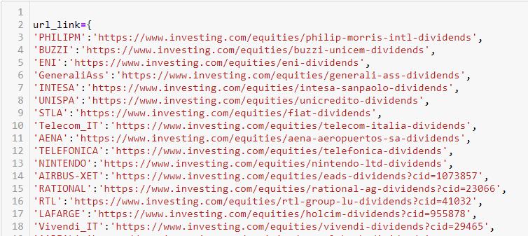
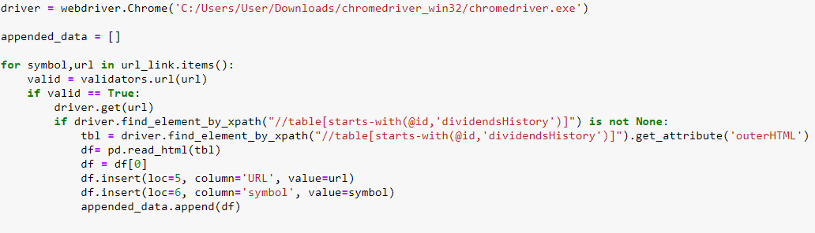
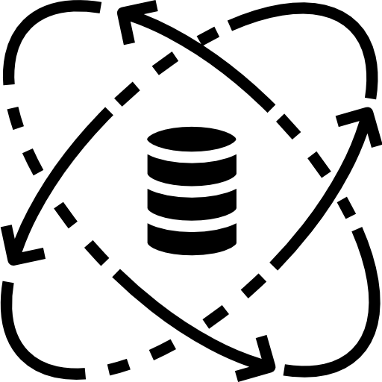

Data sources
Using the Google Chrome browser, import data with selenium.
Save the data to an Excel file.
Convert data from Excel to Python representation using the ‘pandas’ library.

Slide 6
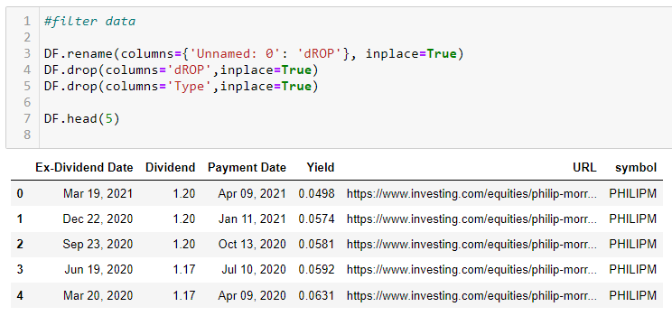

Data cleaning
• Concatenation of all the information while adjusting the columns into a uniform format
• Filter duplicates and empty values
• Outliners handling

Slide 7
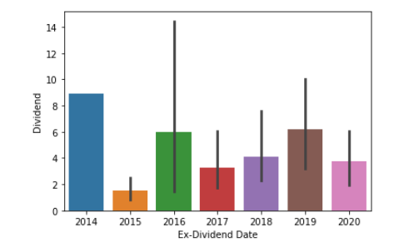
EDA - Exploratory data analysis
Name : A line graph that compares the size of the dividend against the years
What does the graph contain : X – The amount of the dividend
Y – Years divided
Conclusion : The dividend distribution in 2014 was the highest ever.

Slide 8
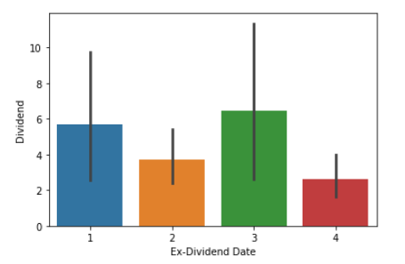
EDA - Exploratory data analysis
Name : Which quarter saw the greatest dividend distribution?
What does the graph contain : X – Shows the quarters
Y – The amount of the dividend
Conclusion : The highest dividend was paid in the third quarter.

Slide 9
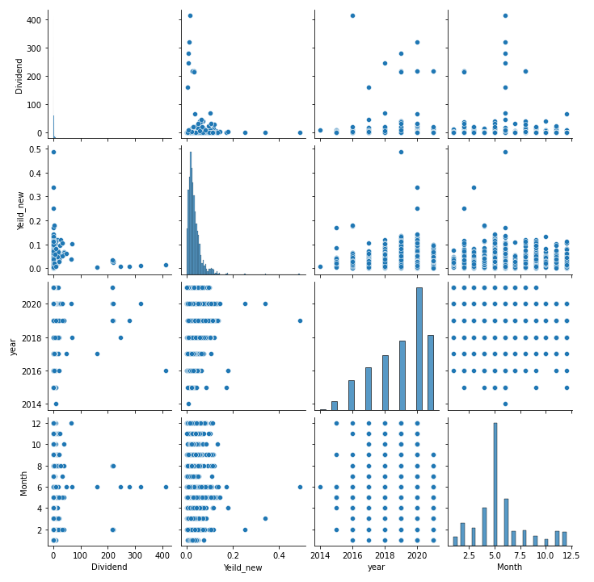
EDA - Exploratory data analysis
Name : An overall graph that depicts a specific variable in relation to the other variables.

Slide 10

Machine Learning

Slide 11

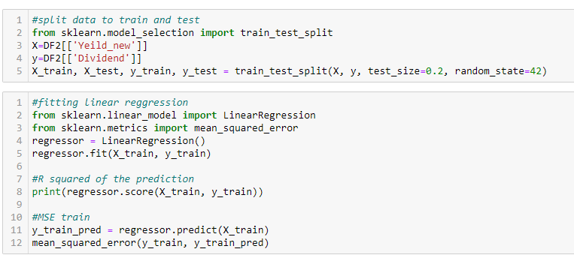
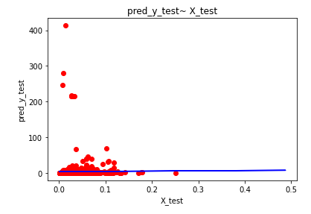
Machine Learning
Using `sklearn` library and linear regression. We were able to train a model that predicts return using dividends.
We will divide the data into 20% test and 80% training, trust the model on the training set, and test the model.
Using MSE, predict dividend values based on test data and compare them to actual data.
The regression line is depicted in a graph.
Conclusion: Return cannot predict dividends.

